Slide 1
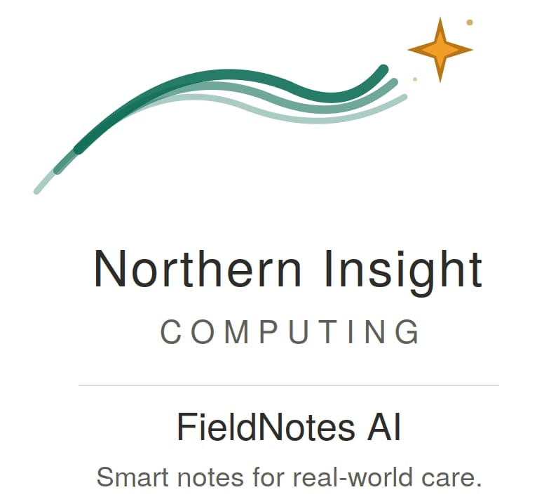
FieldNotes AI
Case Management for Social Workers
Jarillo Consulting · CMPUT 401 · University of Alberta

Slide 2

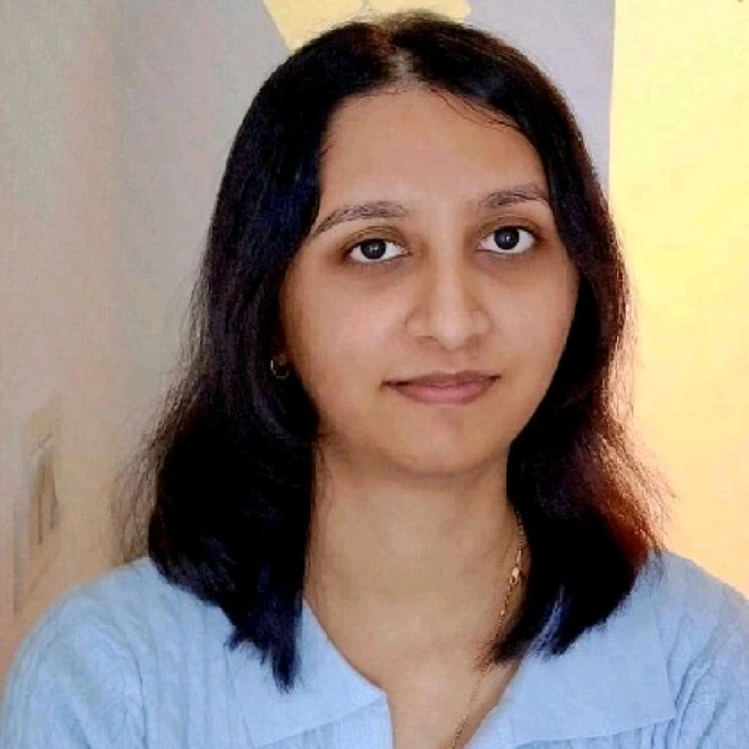




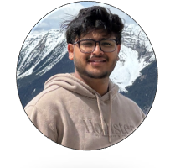
Our Team
Aditya Patel
Pragya Das
📷
Ashwin Chockalingam Shanmugam
Full-Stack
Full-Stack
Full-Stack
Mustafa Sami
📷
Smriti Mohapatra
Salaar Butt
Full-Stack
Full-Stack
Full-Stack
📷
Prajin Raj Pant
Full-Stack

Slide 3
Who Are They?
Jarillo
Consulting
Interested in creating a mobile app for social work agencies
Practitioners manage dozens of active cases simultaneously
Edmonton, AB
Paper-heavy documentation

Slide 4


The Problem We Solved
Hours of admin work
after every session.
Before
After
Endless paperwork
No digital case management
AI transcription + auto-fill
One app for everything

Slide 5




Technologies — Core Stack
React Native & Expo
Supabase
TypeScript
One codebase → iOS, Android & Web
Database, Auth, Storage & Realtime
Strict typing across the full codebase

Slide 6




Technologies — AI & Dev Tools
Azure OpenAI
(GPT-4o)
Azure
Speech SDK
GitHub Actions + SonarQube
Summaries, auto-fill & extraction
Real-time session transcription
Styling + CI/CD quality gates

Slide 7
Sprint Accomplishments — Sprints 1 – 3
S1
S2
S3
Foundation
Core Features
AI Integration
• Auth, roles & navigation
• Consent + audio recording
• Speech transcription
• Case & client CRUD
• Form template upload
• Auto-fill forms
• Emergency SOS

Slide 8
Sprint Accomplishments — Sprints 4 – 5
S4
S5
AutoFill & Polish
Ship It
• Recording trash & restore
• Vercel(web) + EAS(app) deployment
• Notifications
• Accessibility & SonarQube
• Client handoff & docs

Slide 9
EXPERIENCE & LEARNINGS
01
REAL CLIENTS
CHANGE EVERYTHING.
Every sprint, our weekly check-ins with Mr. Jarillo sent us back to the drawing board. Real-world feedback beats any spec doc.

Slide 10
EXPERIENCE & LEARNINGS
02
ONE CODEBASE,
THREE PLATFORMS.
iOS, Android, and web each had unique quirks; audio APIs, keyboard behaviour, file handling. React Native saves time, but platform-specific code is unavoidable.

Slide 11


More Things We Learned
Tests save you
🤝
Continuous Communication
50+ acceptance tests caught regressions before they hit the client.
Daily standups and async Discord kept seven people aligned.
Security is day one
Supabase RLS and role-based routing built in from the start.

Slide 12
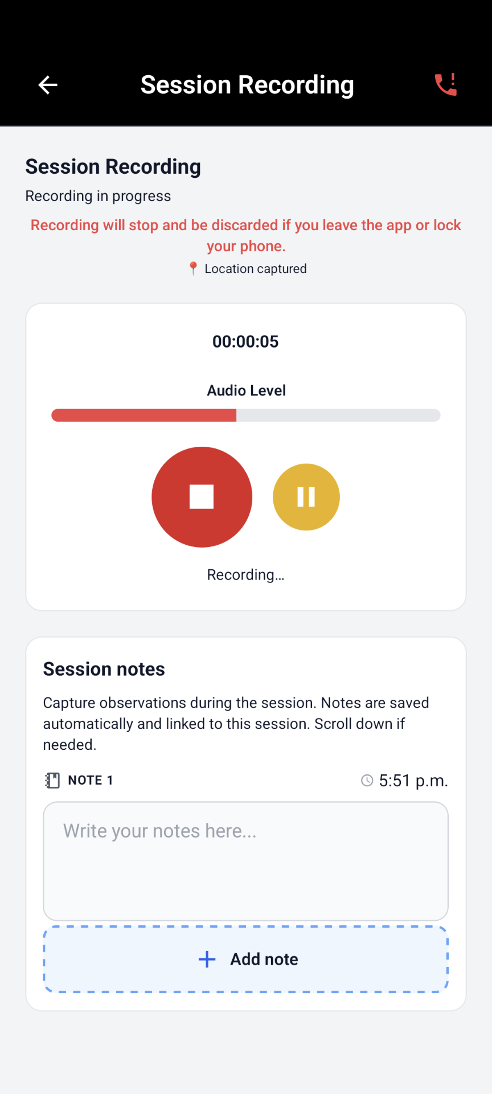
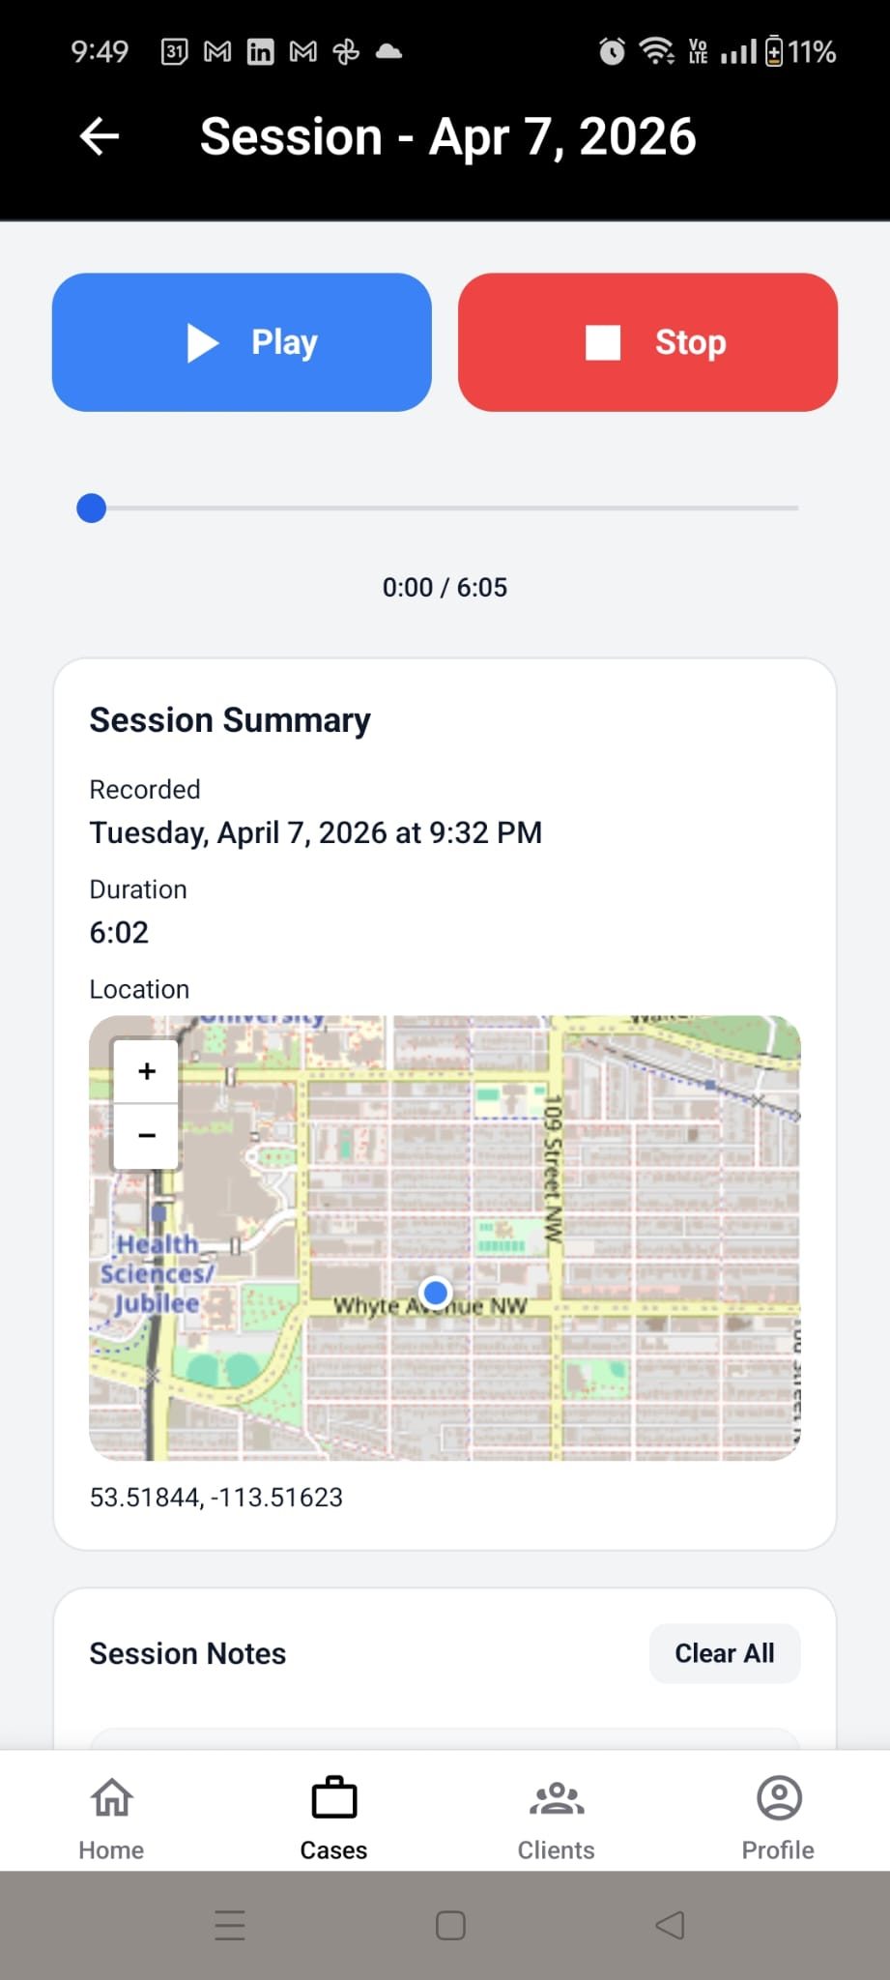
Session Recording
Record.
Pause. Sync.
• Consent screen before every recording
• Pause / resume with real-time volume indicator
• Consented location capture before every location

Slide 13
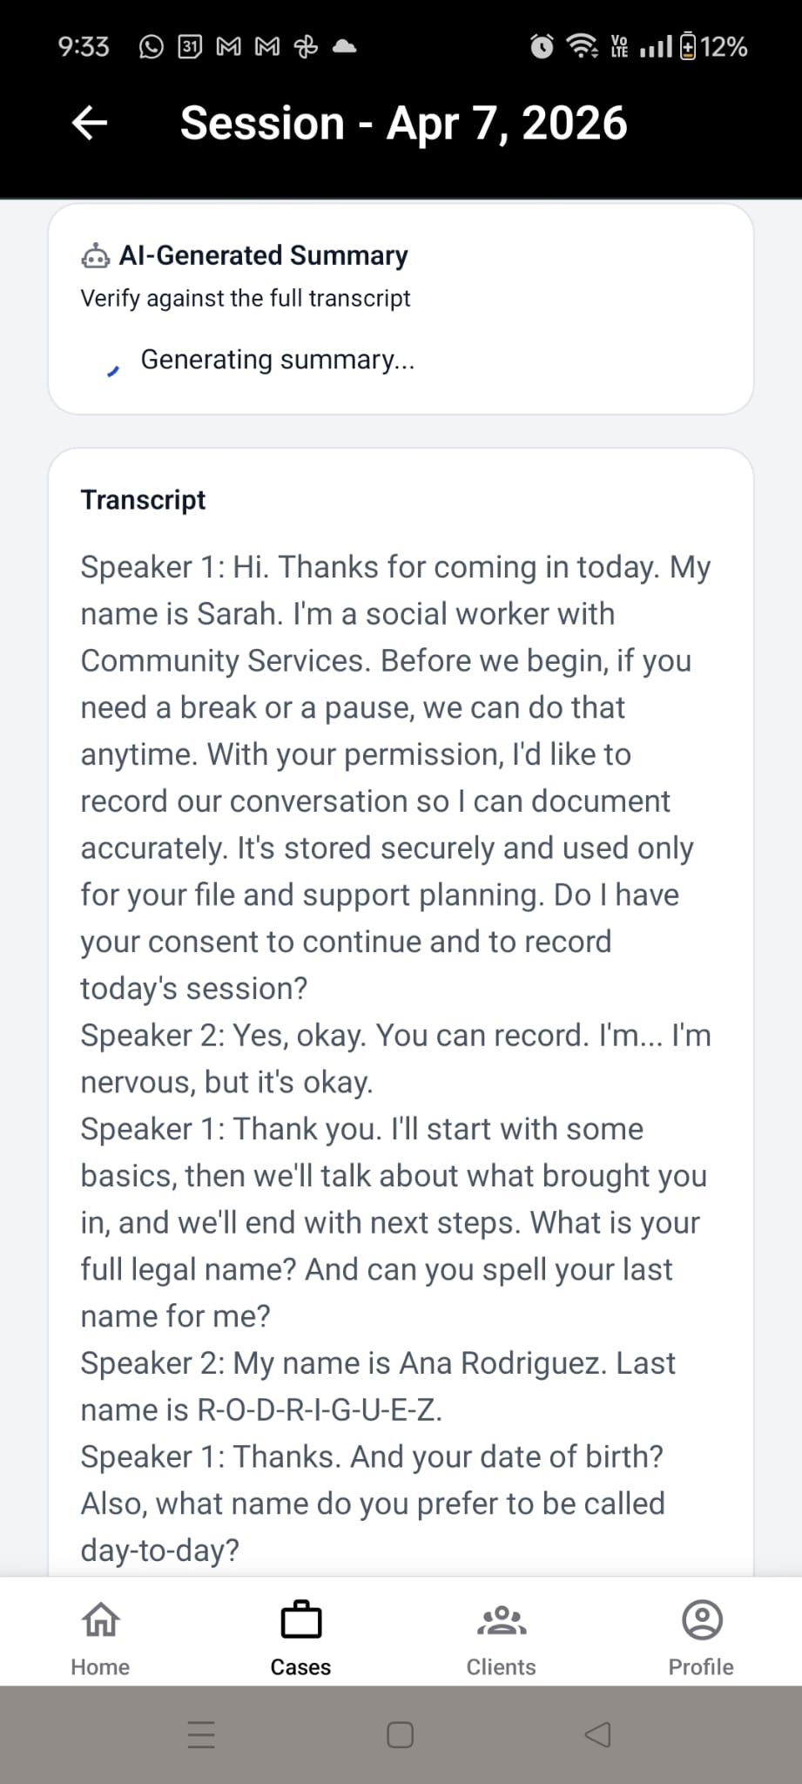
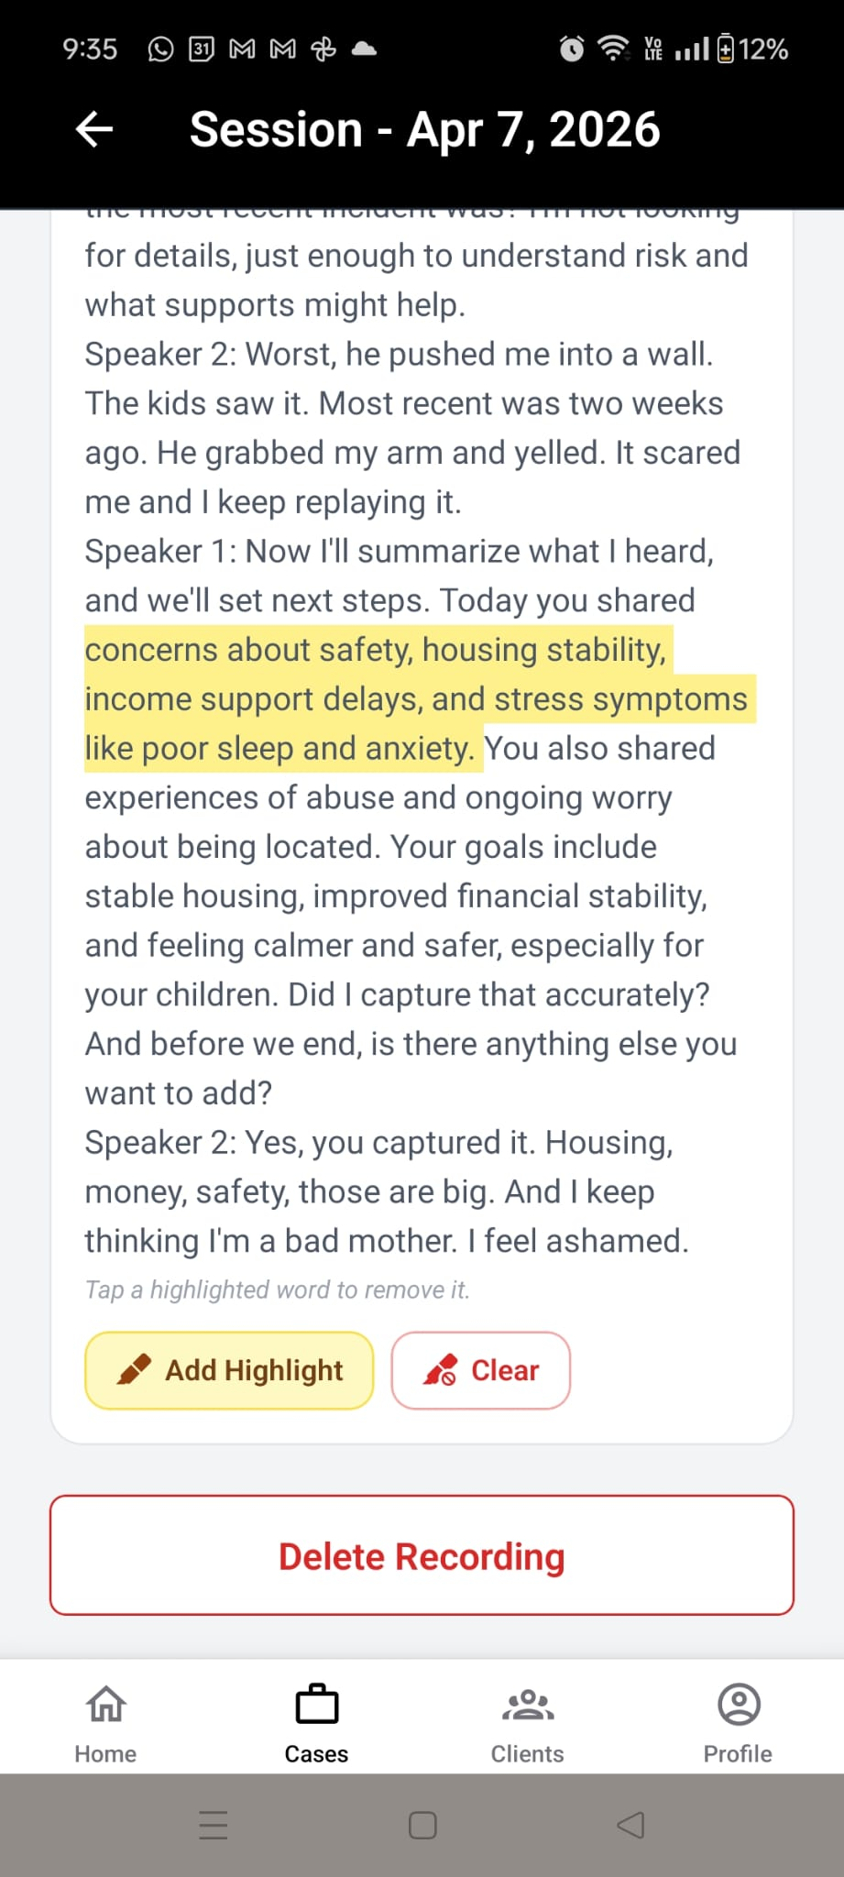
AI Transcription & Summaries
Voice →
Session Notes.
• Azure Speech transcribes the full session
• AI writes a professional summary
• Highlights and one-click regeneration

Slide 14
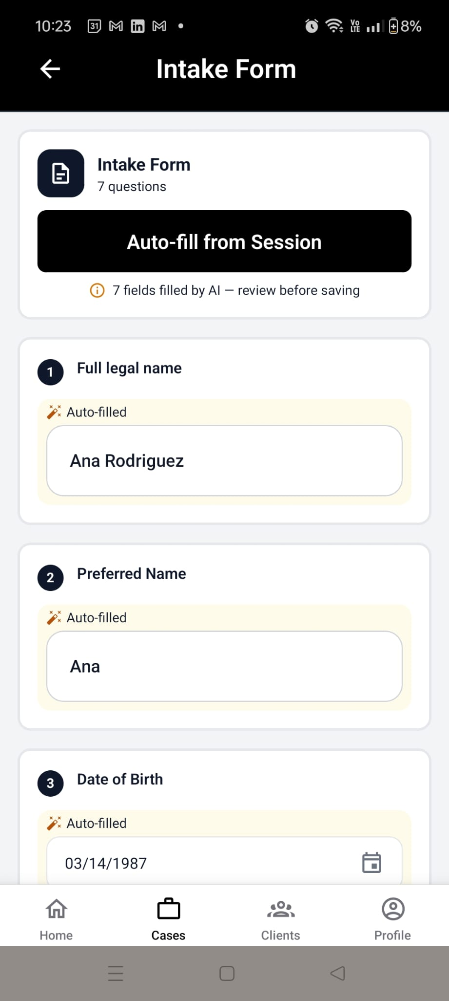
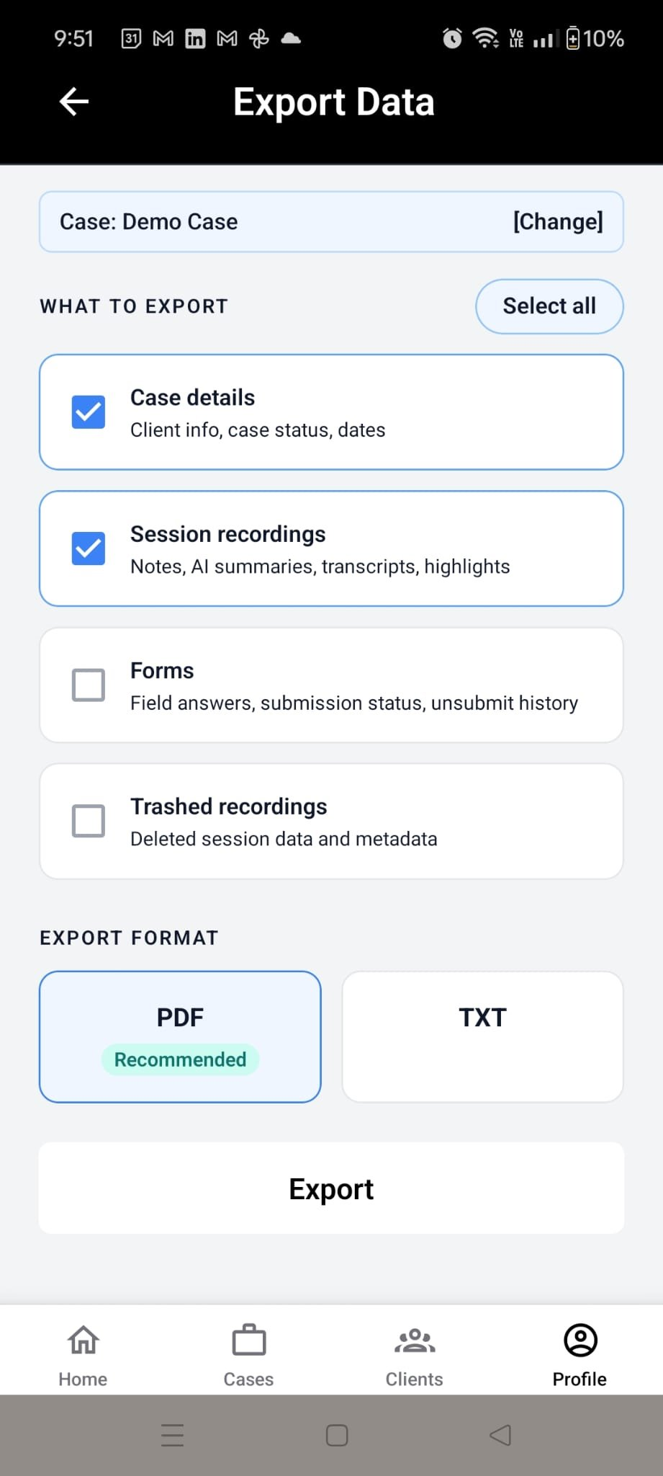
AI Auto-Fill Intake Forms
Forms that fill themselves.
Easy export.
• AI maps transcript → form fields
• Practitioner reviews before submitting
• Export data as txt or pdf files

Slide 15
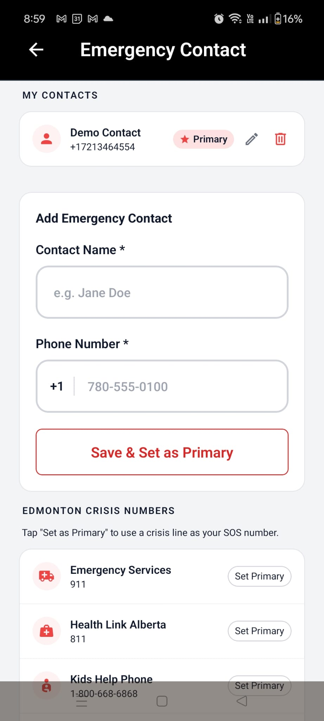
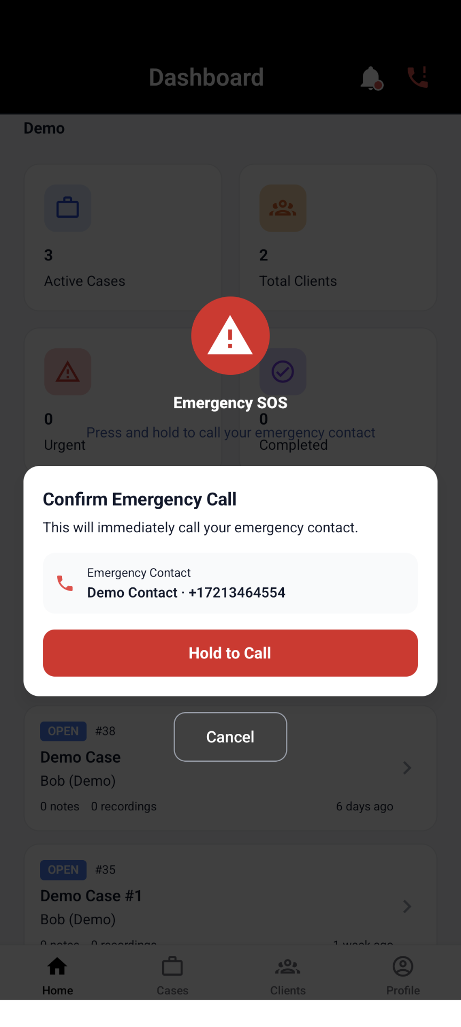
🚨 Emergency SOS
Help in
one tap.
One-tap SOS with primary contact badge
Built-in Edmonton crisis numbers

Slide 16
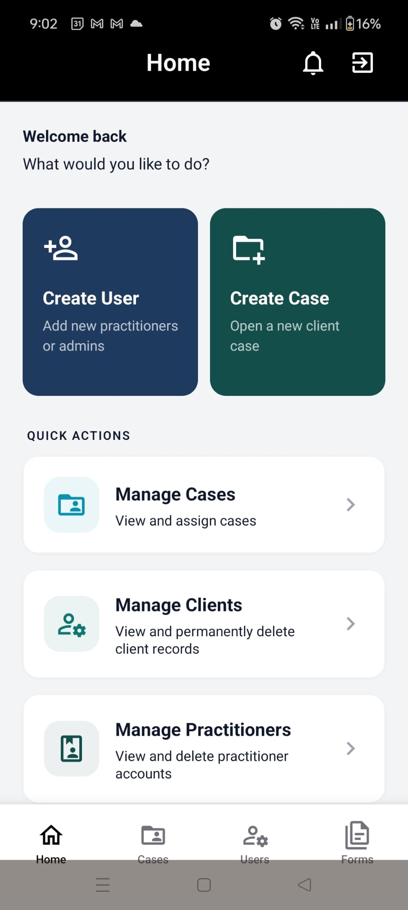
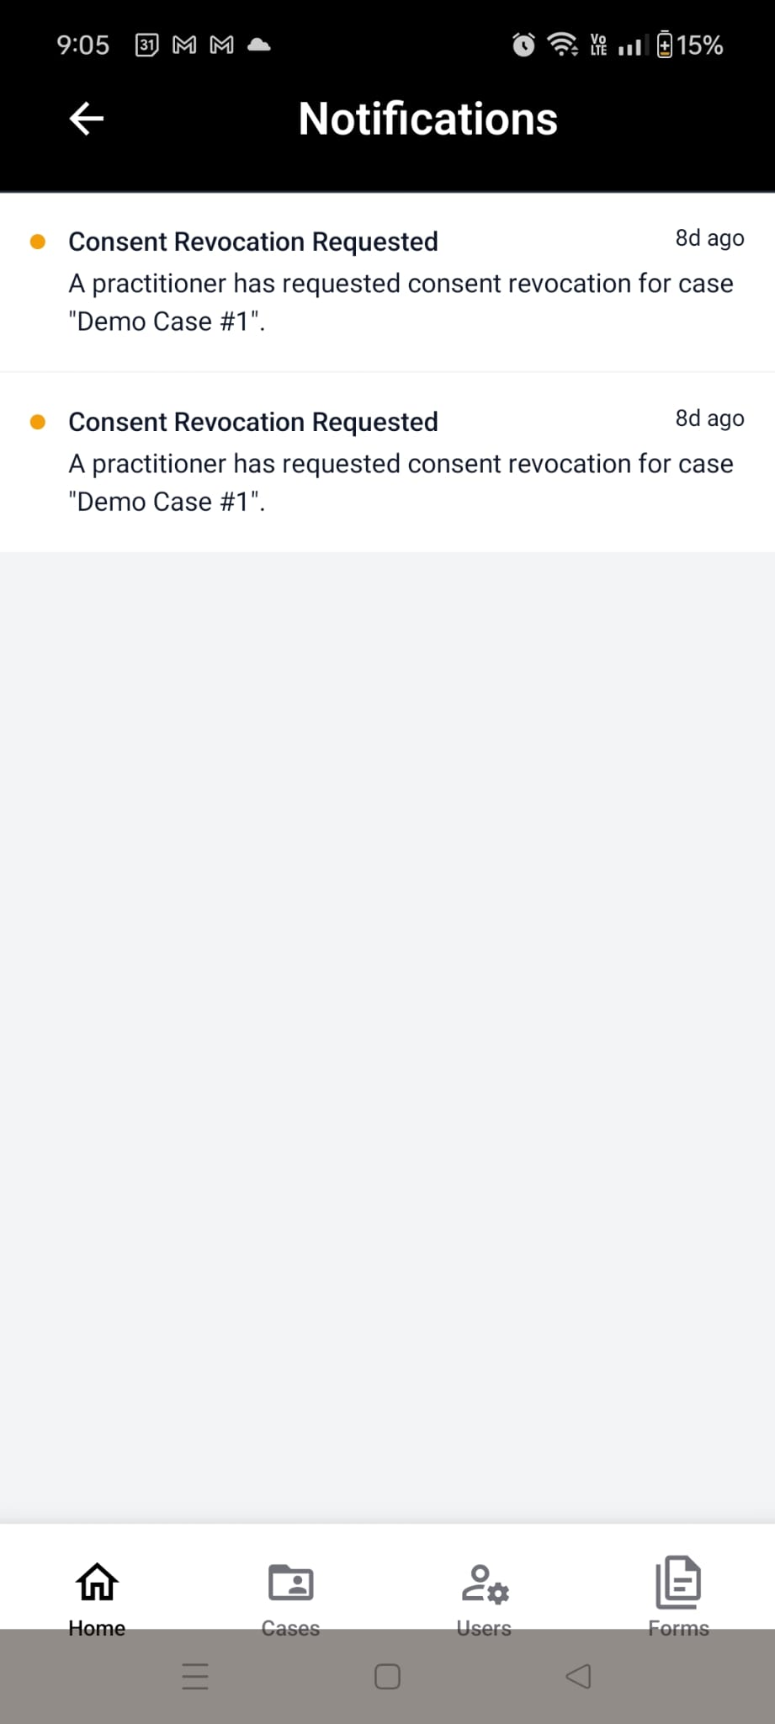
Two Roles. One App.
ADMIN
▸ Manage users, cases & forms
▸ Notifications for consent revocations
▸ Assign practitioners to cases

Slide 17
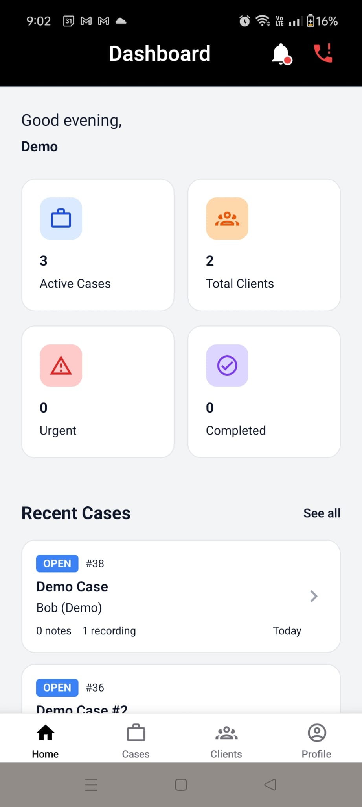
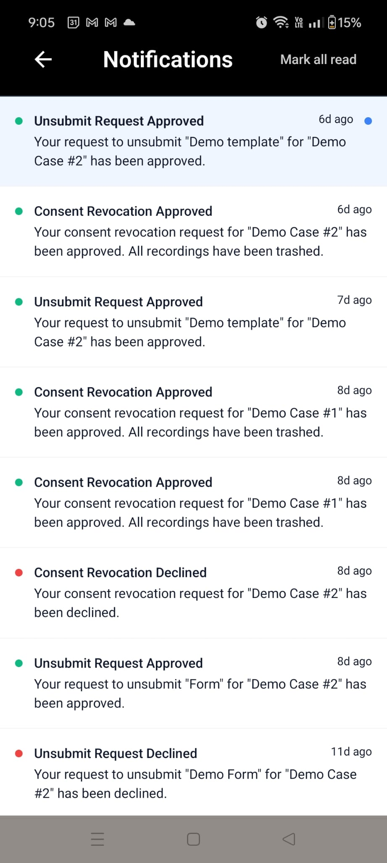
Two Roles. One App.
PRACTITIONER
▸ Full recording workflow
▸ AI forms and summaries
▸ Export case as PDF
▸ Notifications

Slide 18



Deployment
Web App
Mobile
Vercel
EAS Expo
Auto-deploys to pre-prod(private) or production from dev/main branches
iOS & Android + OTA updates
️
Backend
AI Services
Self-Hosted Supabase
Microsoft Azure
DB, Auth, Realtime & Storage
GPT-4o + Speech

Slide 19
CLIENT-TEAM COLLABORATION
Client was very pleased
Clear vision and active feedback
Deployed
to Production
Client
Handoff Done
Full
Documentation

Slide 20
FieldNotes AI
Empowering Social Workers with AI
20+
50+
5
7
Features
Acceptance Tests
Sprints
Team Members
Thank You!

